Slide 1
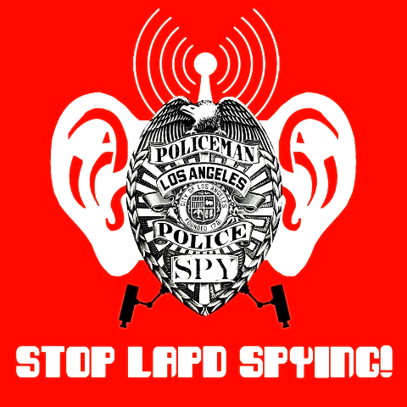
Predictive Policing
FAQ

Slide 2
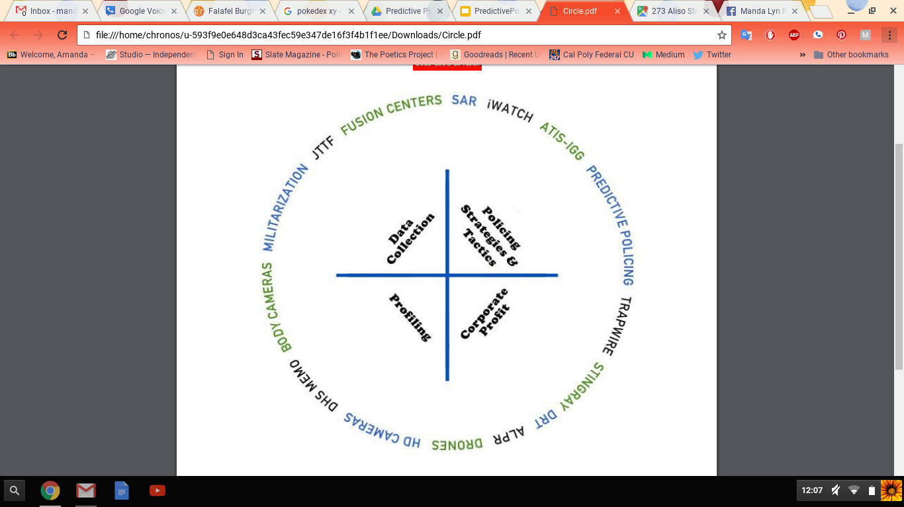
The Architecture of Surveillance

Slide 3
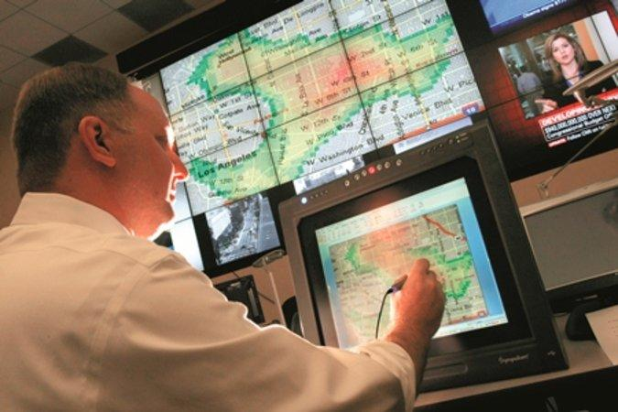
What is Predictive Policing?
Predictive Policing is a police strategy that applies secret computer algorithms to past crime data to “predict” where crime will be committed and who will commit crime.

Slide 4
PredPol
Operation LASER

Slide 5
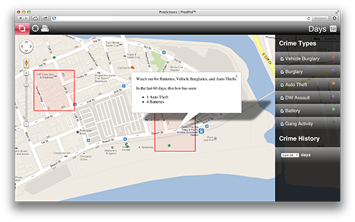
PredPol
Claims to predict where crime will happen
Predpol is a company that profits from selling its software to police.
Predpol’s computer algorithms use past reported crime data to “predict” where crime will be committed.
Police concentrate their presence in areas predicted by the software- these areas are called “hotspots”.

Slide 6
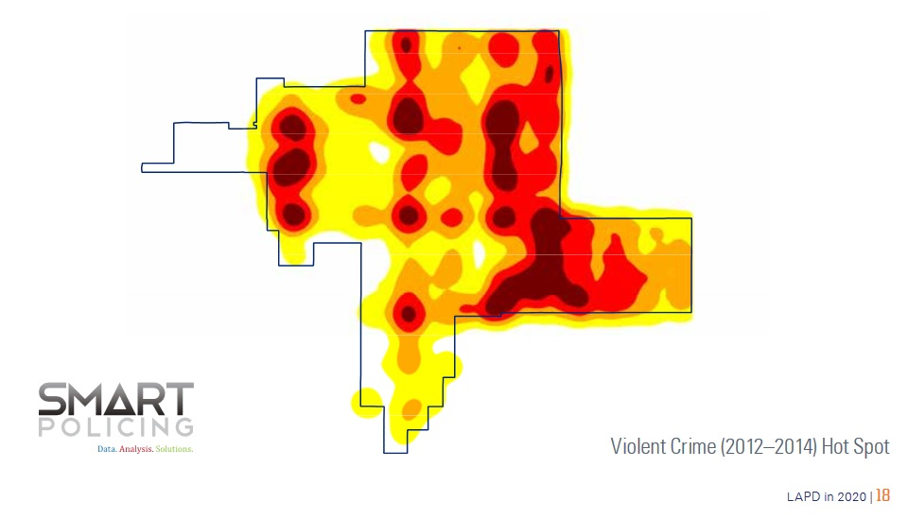
Operation LASER
Claims to predict who will commit a crime
LASER uses past crime data and criminal records to create “Chronic Offender Bulletins,” similar to most-wanted posters, which identify specific people as likely “future” criminals.
Police pay special attention to those people with a Chronic Offender Bulletin and the neighborhoods in which they live.
LASER also uses other spying tools, such as license plate scanners, closed-circuit television, and cell phone trackers, to track and trace people.

Slide 7
Why should I be concerned?

Slide 8
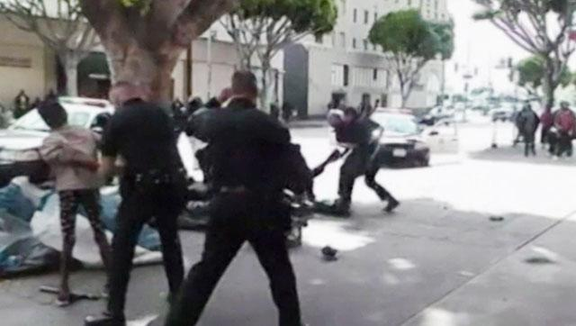
Predictive policing creates a feedback loop of injustice
Black and Brown people are stopped, detained, frisked, and arrested more often than their white counterparts .
Predictive policing continues the never-ending cycle of policing the same people. Predpol sends police into a community and police will inevitably target Black and Brown people.

Slide 9
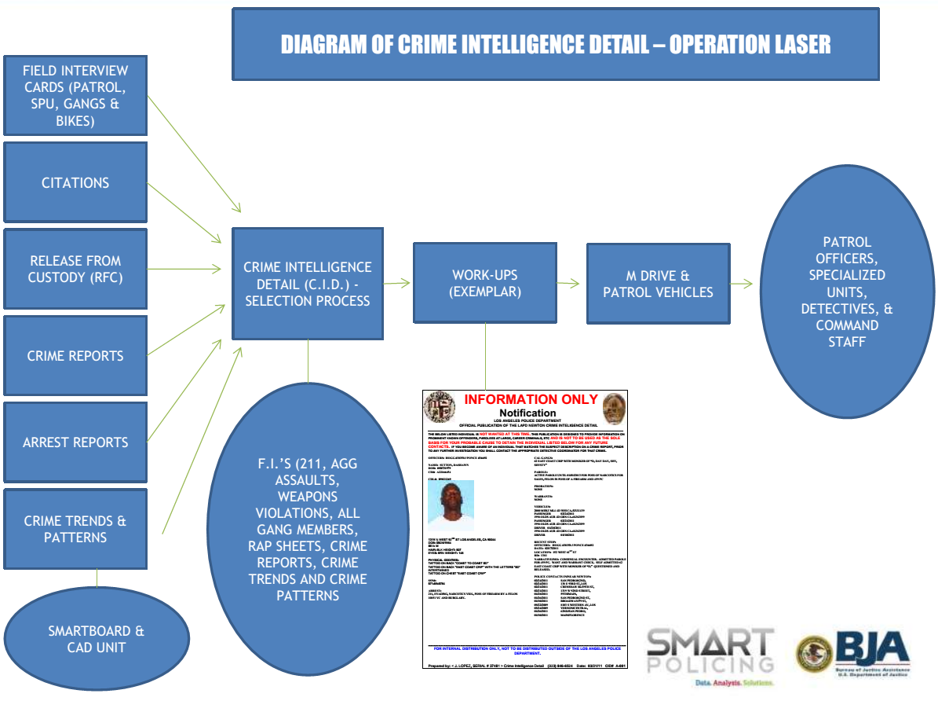
Predictive policing masks racist policing practices behind computer algorithms
Predictive policing claims to be fair and neutral and driven only by community members who are calling police. However no matter how or why police are sent into a community they always target and harass Black or Brown people.

Slide 10

Police use the hotspots and suspect lists to justify the continued harassment and abuse of vulnerable communities
Police put individuals and their neighborhoods under increased scrutiny
The use of algorithms and hotspots gives police the easier cause for ‘reasonable suspicion’ under the law to stop and frisk people and ‘probable cause’ to justify an arrest.

Slide 11
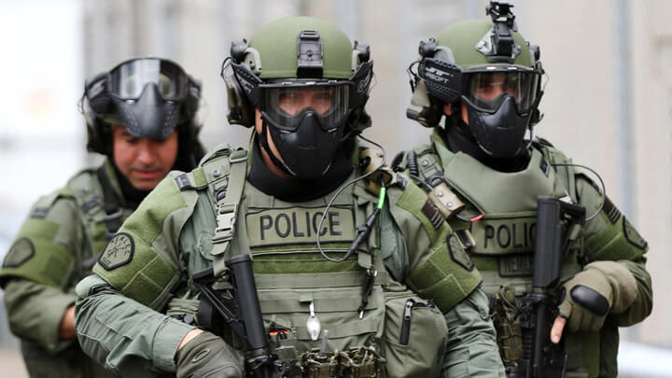
﻿Predpol’s technology was first used by the military in Iraq and was funded partly by grants from the Army Research Office.
LASER uses CIA-developed software.
The Continued Militarization of Policing:
War Abroad and War At Home

Slide 12
Profit-Driven Public Safety
The companies that sell “predictive” police technologies profit off concerns about public safety while poor communities and communities of color suffer the consequences.

Slide 13

What can I do about it?

Slide 14
Host a focus group in your community and start the conversation about policing and its impact on the community!
Go to the Los Angeles Board of Police Commission and demand that they stop using predictive policing programs. Oakland community residents did it - so can we!
Join our Campaign. We meet every 4th Tuesday of the month at 6pm at Los Angeles Community Action Network located at 838 E. 6th St. (x street Gladys St.)
Contact us! Stoplapdspying@gmail.com or call (424) 209-7450

